Slide 1
Data Engineering
-Final Project-
Web Scraping - Beautiful Soup
Presenting by Yvonne Gan

Slide 2

The News Website
Facts:
News based in Singapore, currently owned by Singapore Press Holdings.
First established was on 15 July 1845.
Selection:
Selected “The Straits Times - Global” as it has more available contents to explore without much limitations.
The connection status is 200, this means it is successfully responses to the HTTP requests.

Slide 3
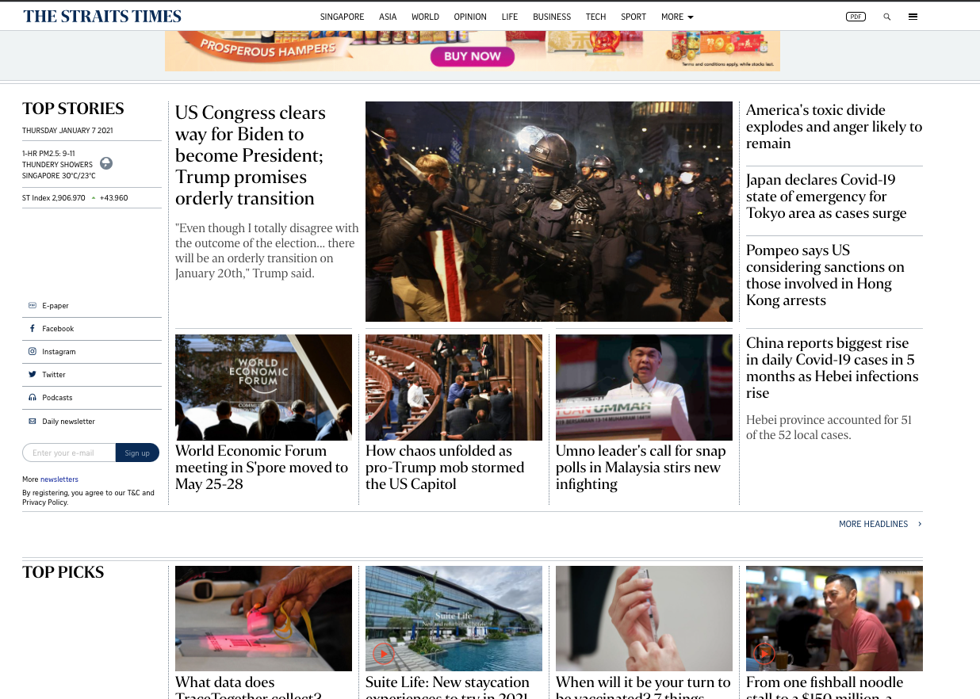
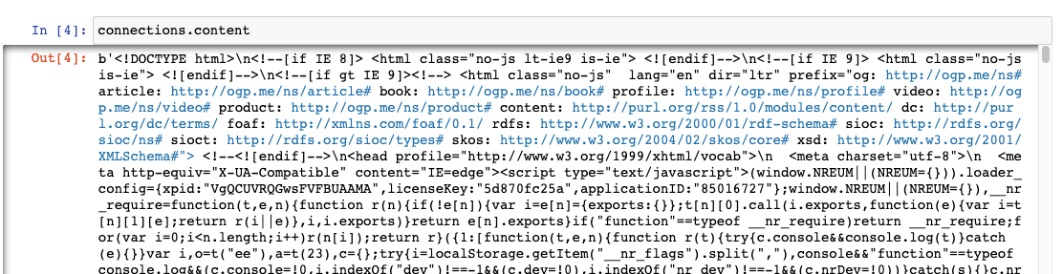
Overview
On the top is an actual view of the news website. As we can see it starts with TOP STORIES then follow by TOP PICKS structure.
The bottom is a snippet of the website contents parsed by using Beautiful soup.

Slide 4
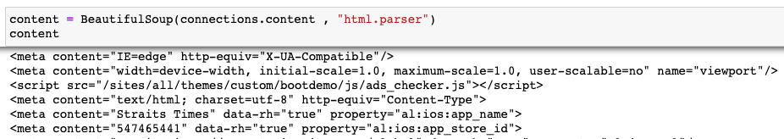
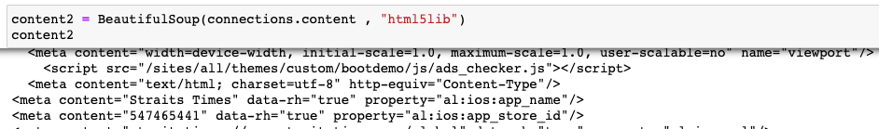
Parsers
html.parser
html5lib
Observations:
html.parser good for retrieve the contents but it is not as completes as html5lib as html5lib is more compate as it parses pages the same way a web browser does.
The issue and differences are as above, html.parser some attributes not having the close tag whereas html5lib is better at this.*
Notes:
** Without the proper closing tag, it could caused an issue such as our query may grab all the attributes(lines) from the opening tag until the end of the available closing tag. These could mean many to thousand attributes compiled as One based on the open and closing tags

Slide 5
Page <title> </title>
<title>The Straits Times - Breaking News, Lifestyle &amp; Multimedia News</title>

Slide 6
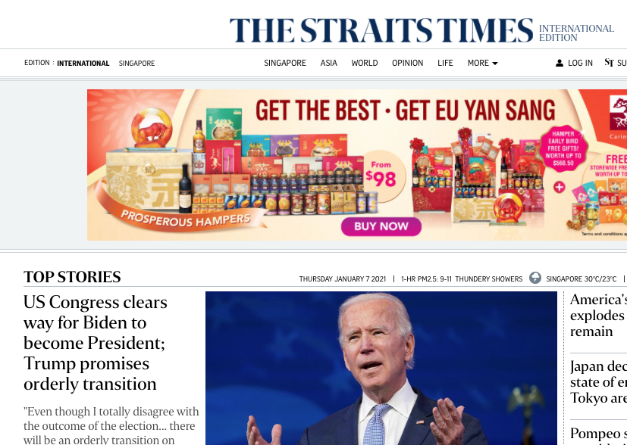
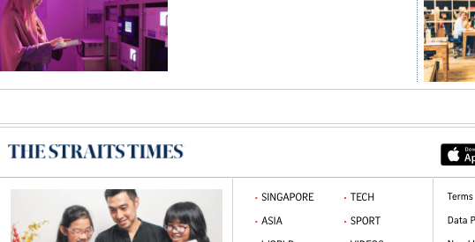
Headlines & Subheadlines
Discovered up to 2 headlines and 2 sub headlines
h1 (headline) | “site-name”
h2 (headline) | “pane-title”
h3 (sub headline) | “story-title”
h4 (sub headline)
<h3>
<h2>
<h1>
<h4>

Slide 7
Others
div | class = “ panel - separator”
“a” | “href”
“meta”
Additional tags

Slide 8
Thank you! :)

